Slide 1
Project Scheduling

Slide 2
Motivation
The Question:
How long will it take to complete a specific (design or implementation) project (or part of a project)?
A Naive Approach:
Add the effort estimates for each task

Slide 3
An Example You Have Experience With
The Questions:
How long will it take me to complete a particular major?
The Givens:
The courses that must be completed
The time required to complete each course (e.g., a block, a semester, a year)
The number of times I will need to take each course
When the courses are offered
The prerequisites for each course

Slide 4
An Example You Have Experience With (cont.)
Another Question You Might Ask:
Which courses can't I afford to miss or fail?
Generalizing This Question:
Which tasks can/can't be delayed without delaying the completion of the project?

Slide 5
Shortcomings of the Naive Approach
An Overview:
Units Matter
Task Details Matter
Task Dependencies Matter
Personnel Capabilities Matter

Slide 6
Units Matter
Effort (E):
Measured in person-days or person-months (or even story points)
Time (T):
Measured in days or months
The Implication:
Thinking only about units, T=E/N, which means that N (i.e., the number of people working on the project) matters

Slide 7
Task Details Matter
A Property of Very Small Tasks:
They can only be worked on by one person at a time (hence, T=E/N only applies when N=1)
A Property of Many Tasks:
Large values of N can make things worse (the Brooks’s Law)

Slide 8
Task Dependencies Matter
Sequential Tasks:
Must be completed in order
Simultaneous/Parallel Tasks:
Can be completed at the same time

Slide 9
Personnel Capabilities Matter
An Observation:
Different members of the team have different knowledge, skills, and abilities
Implications:
Personnel may make it impossible to complete tasks in parallel
A "person" is not a homogeneous thing

Slide 10
An Example
The Setting:
The design and implementation of a new computer game
Where we are in the Process:
The major tasks in the process have been identified at a low level of detail
The time required for each task has been estimated
The task dependencies have been identified

Slide 11
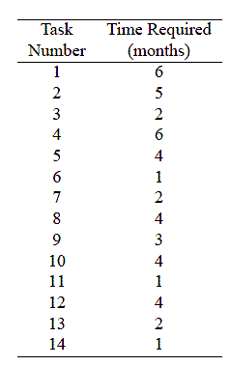
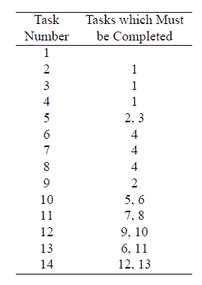
An Example (cont.)
The Time Required for Each Task
The Task Dependencies

Slide 12
Solving the Problem
Some Observations:
This problem is not unique to software projects
There are many ways to solve it (and variants of it)
Techniques:
Critical Path Methods
Gantt Charts
Program Evaluation and Review Technique

Slide 13
Critical Path Methods

Slide 14
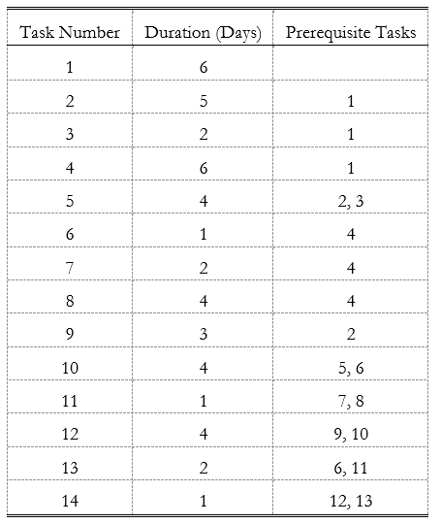
An Example
The Input Data

Slide 15
Learning From An Example
Apparently:
It's possible to put all of the necessary information in a table
Unfortunately:
The table can be confusing
Allaying the Confusion:
Use some discrete math (i.e., a graph)

Slide 16
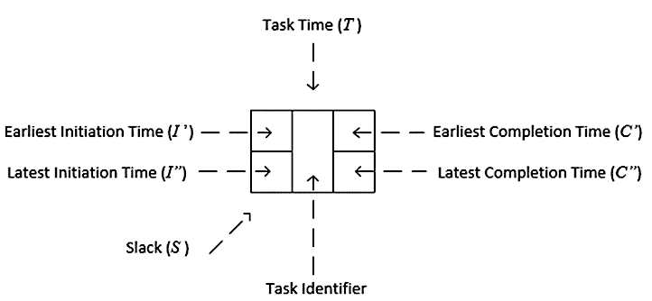
Vertices

Slide 17
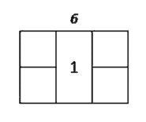
Building the Graph
Getting Started

Slide 18
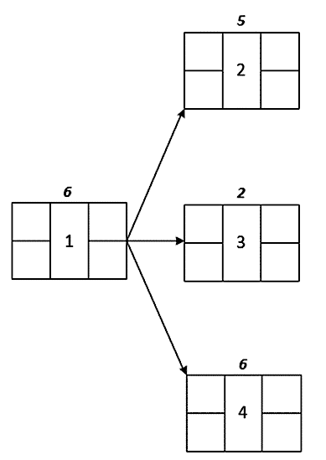
Building the Graph (cont.)
Adding Dependencies

Slide 19
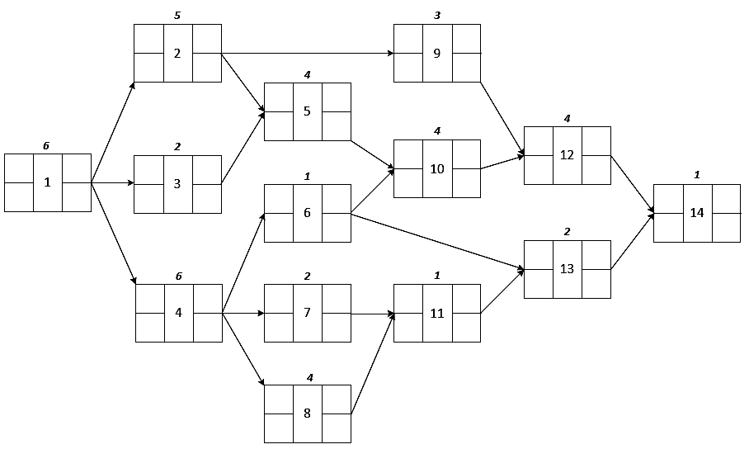
The Complete Graph

Slide 20
Earliest Times
Earliest Initiation Time:
I′_{i} is the initiation time for task i assuming the preceding tasks are completed as early as possible
Earliest Completion Time:
C′_{i} = I′_{i}+ T_{i}

Slide 21
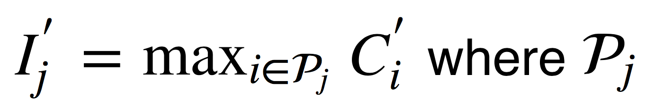
Earliest Initiation Time
For the Initial Task:
0
For Other Tasks:
I′j=maxi∈jC′i where j is the set of prerequisite tasks for task j

Slide 22
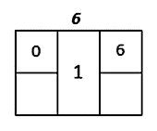
Earliest Times (cont.)
Visualization for Task 1

Slide 23
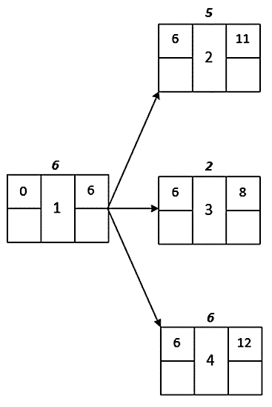
Earliest Times (cont.)
Visualization for Tasks 2, 3, and 4

Slide 24
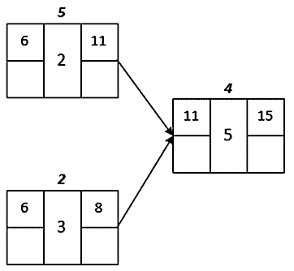
Earliest Times (cont.)
Visualization for Task 5

Slide 25
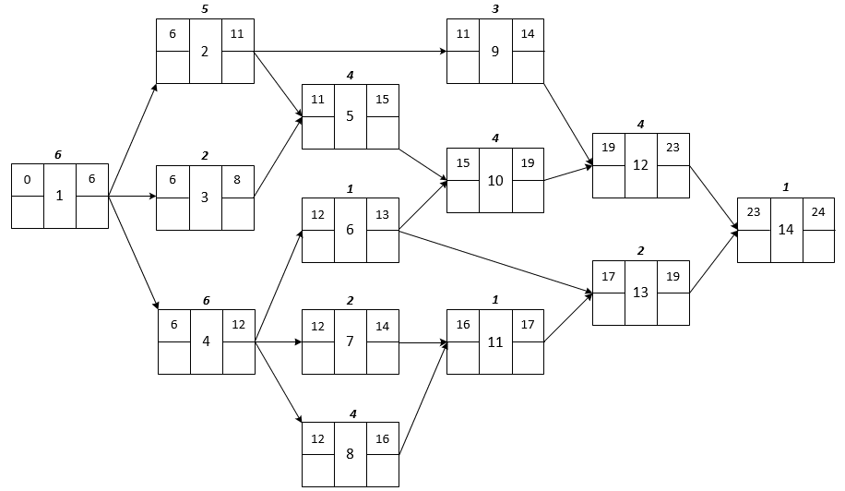
Earliest Times (cont.)

Slide 26
Latest Times
Latest Completion Time:
C″_{i} is the last time task i can be completed without delaying the project beyond its earliest time
Latest Initiation Time:
I″_{i}= C″_{i}− T_{i}

Slide 27
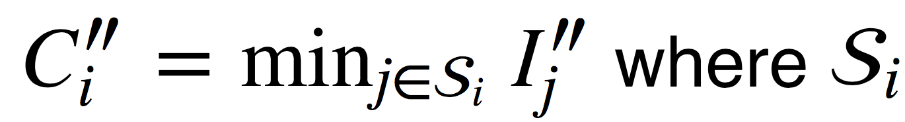
Latest Completion Time
For the Last Task:
The earliest completion time
For Other Tasks:
C″i=minj∈iI″j where i is the set of tasks that are subsequent to task i

Slide 28
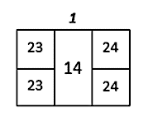
Latest Times (cont.)
Visualization for Tasks 14

Slide 29
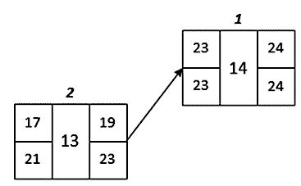
Latest Times (cont.)
Visualization for Tasks 13

Slide 30
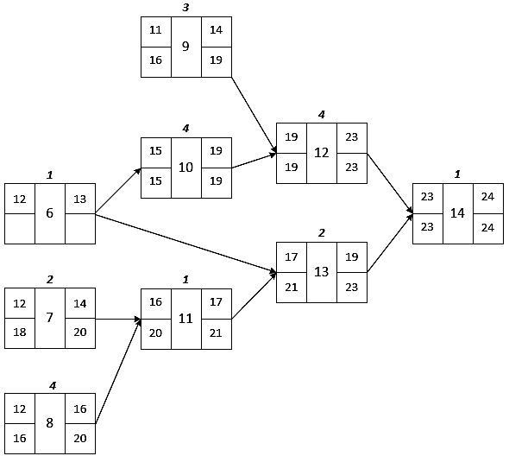
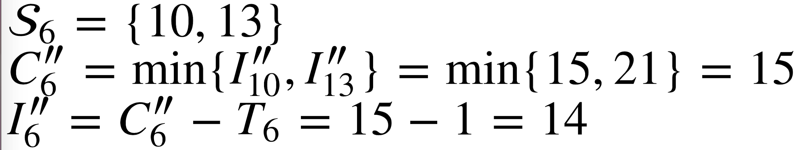
Latest Times (cont.)
Visualization for Tasks 7 to 14
Task 6:
14
15

Slide 31
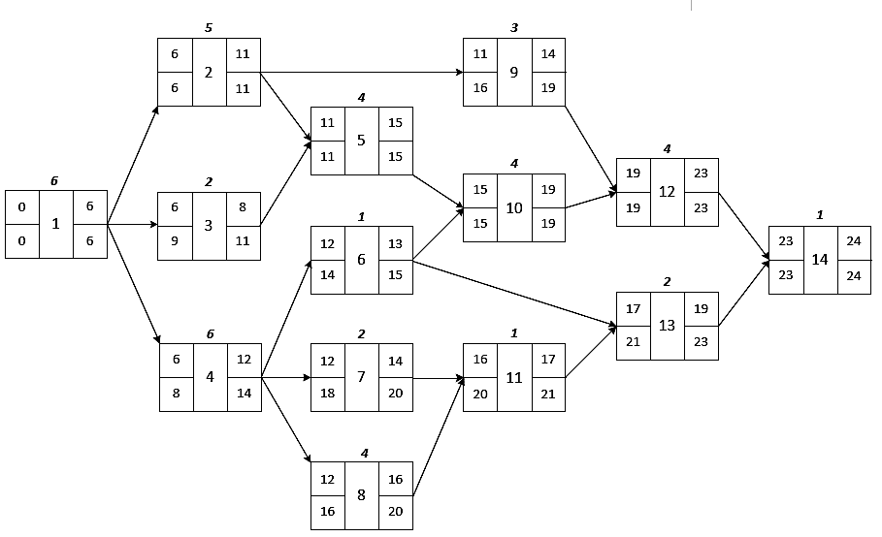
Latest Times (cont.)

Slide 32
Slack Times
Intuition:
The difference between the latest completion time and the earliest completion time
Formally:
S_{i}=C″_{i}− C′_{i}

Slide 33
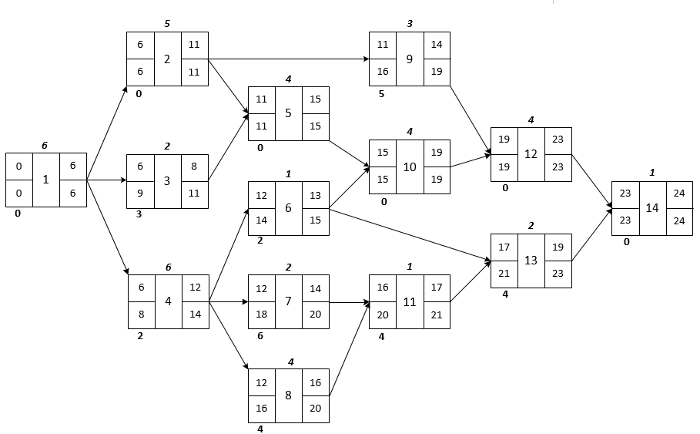
Slack Times (cont.)

Slide 34
Gantt Charts

Slide 35
Visualization
Dimensions:
Time increases from left to right
Tasks are added from top to bottom
Tasks:
Represented as rectangles
The left side is positioned at the earliest possible start time
The horizontal extent corresponds to its duration
The vertical extent is arbitrary
Dependencies:
Represented as arrows

Slide 36

An Example (cont.)
Adding Task 1

Slide 37

An Example (cont.)
Adding Task 2

Slide 38
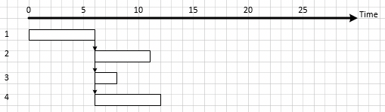
An Example (cont.)
Adding Tasks 3 and 4

Slide 39
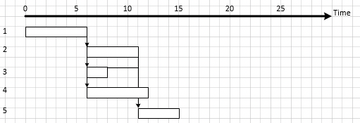
An Example (cont.)
Adding Task 5

Slide 40
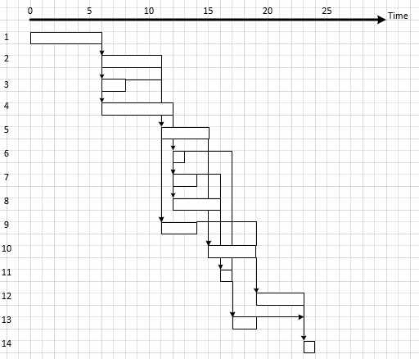
An Example (cont.)
All Tasks

Slide 41

Finding the Critical Tasks
The Process:
Start with the task with the latest completion time
Work backwards and find the predecessor that has the latest end time
Continue
The Example
Start with task 14
14 has two predecessors, 12 and 13, and 12 has the later end time
12 has two predecessors, 9 and 10, and 10 has the later end time

Slide 42
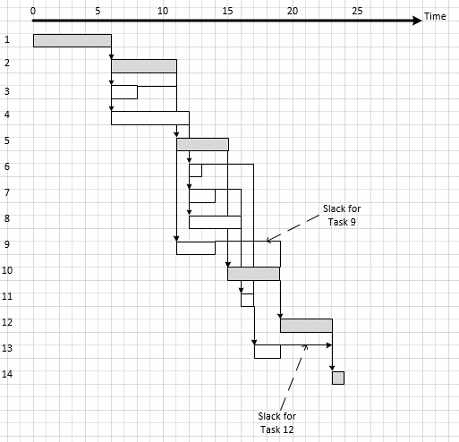
An Example (cont.)
Slack

Slide 43
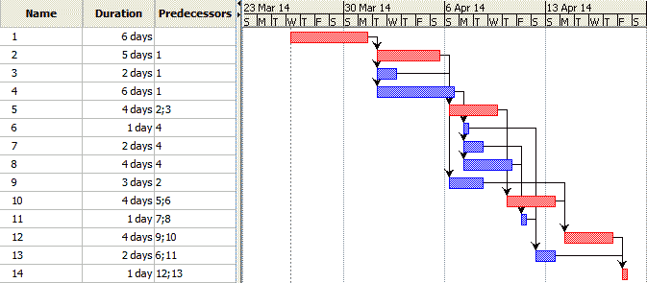
Automated Tools (cont.)
Consider Task 12:
It is red so is on the critical path (so can't slip)
It isn't completed until day 23
Consider Task 9:
It is blue so is NOT on the critical path (so can slip)
It isn't completed until day 14
The black line representing slack is 5 long

